Slide 1
Iowa Liquor Project
Market Research for New Locations
By David Ortiz

Slide 2
Overview
We want to determine new locations to establish storefronts based on the market data provided.
The client is one of the leading liquor stores in the state of Iowa and wants to increase sales by expanding to new locations. We are tasked with generating recommendations for new storefronts based on historical liquor sales in Iowa.
We will use Linear Regression models to predict liquor sales for 2016.

Slide 3
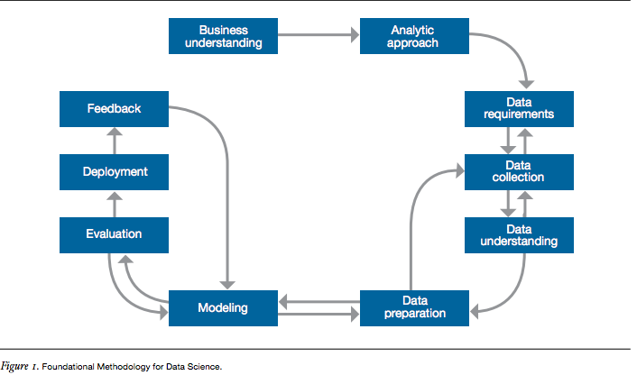
Methodologies
Notes:
John B. Rollins, Ph.D.

Slide 4
Process
Obtained 2015 and 2016 1st quarter data from the state of Iowa
Performed initial data analysis and cleaned up the data set
Used graphs to show correlation between features
Data mined
Built model
Validated model
Predicted sales based on zip code

Slide 5
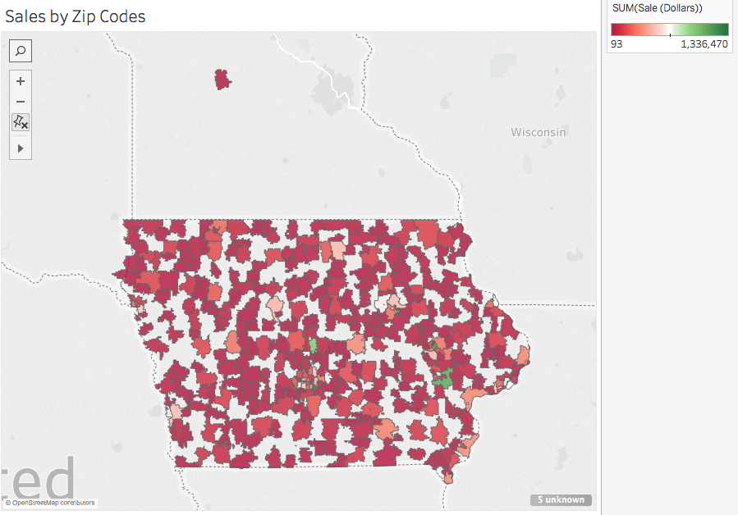
Findings

Slide 6
Findings

Slide 7
Findings

Slide 8
Findings
Independent variables:
Zip Code (Dummy)
Bottles Sold
Volume Sold Liters
Predictor
Sale Dollars

Slide 9
Findings

Slide 10
Findings
Train/test split
66% training region
33% testing region
Score: 0.744823885968
Cross validation
Cross-Predicted Accuracy: 0.736836755927
Notes:
Score/accuracy: Looking at how well the predictions did against true values

Slide 11
Findings
Zip Code | Sale Dollars
50320 | 1071059.83
50314 | 1068930.72
52402 | 981966.84
52240 | 876783.44
50010 | 771870.49
Store Number | City | Zip Code | Sale Dollars
2633 | DES MOINES | 50320 | 1000783.30
4829 | DES MOINES | 50314 | 877892.36
3385 | CEDAR RAPIDS | 52402 | 441983.55
2512 | IOWA CITY | 52240 | 419746.83
3420 | WINDSOR HEIGHTS | 50311 | 352020.66

Slide 12
Conclusion
Based on the score and accuracy of the model I am confident that model can predict the 2016 sales for the top earning store and the location for expansion.

Slide 13
Recommendations
Zip Code: 52240
2016 Predicted Sale Dollars Total: 799177.57041
Zip Code: 50311
2016 Predicted Sale Dollars Total: 384575.827211
Zip Code: 50320
2016 Predicted Sale Dollars Total: 785021.576622
Zip Code: 50314
2016 Predicted Sale Dollars Total: 855169.72950
Zip Code: 52402
2016 Predicted Sale Dollars Total: 759469.685387

Slide 14
Recommendations
City | Zip Code
DES MOINES | 50320
DES MOINES | 50314
CEDAR RAPIDS | 52402
IOWA CITY | 52240
WINDSOR HEIGHTS | 50311

Slide 15
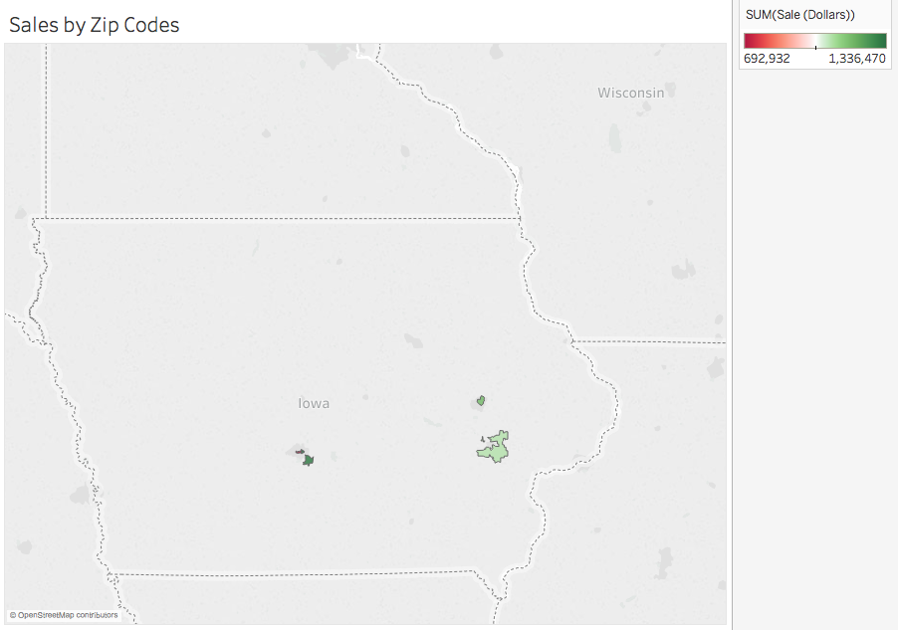
Recommendations

Slide 16
Questions

